Slide 1
Midterm Website
Abrar AlMari

Slide 2
Demo
Website

Slide 3
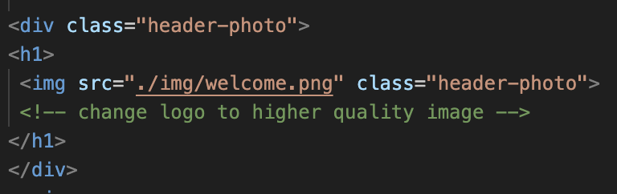
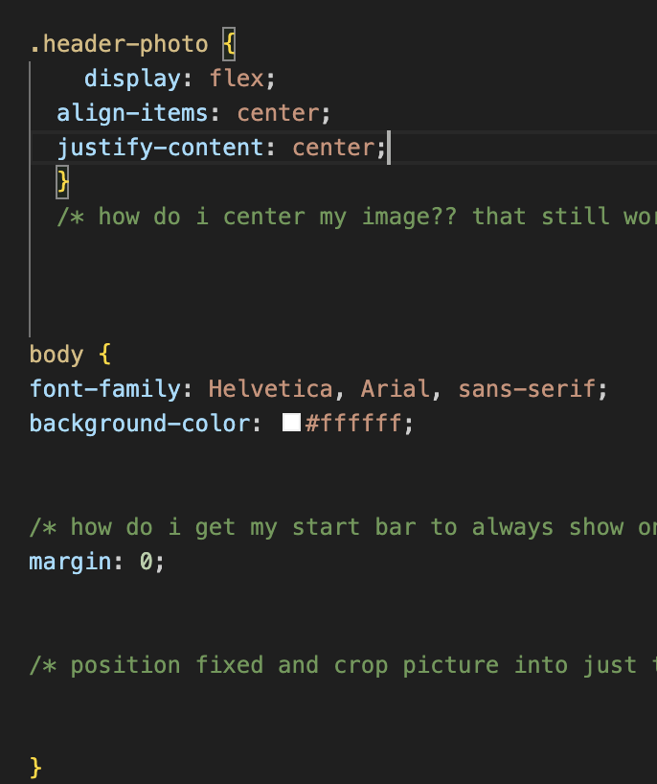
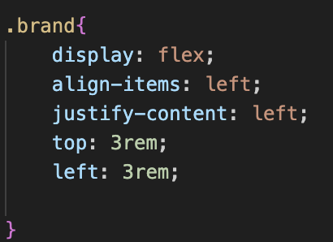
Code Snippets

Slide 4
Next Steps
Increase theme adherence, emulating an actual windows 95 desktop with clickable icons that can lead to the different pages but would still work and still look the same when resized.
Work on gallery wall
Figure out how to include different media like music and video

